Slide 1
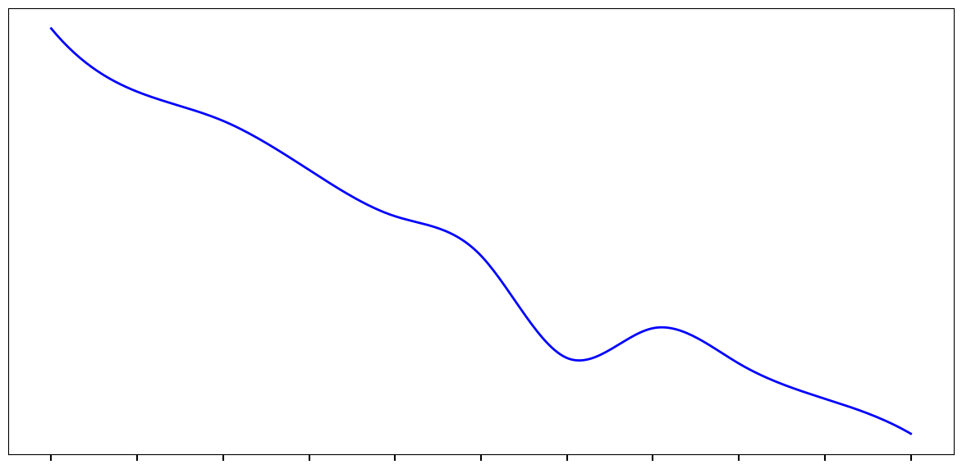
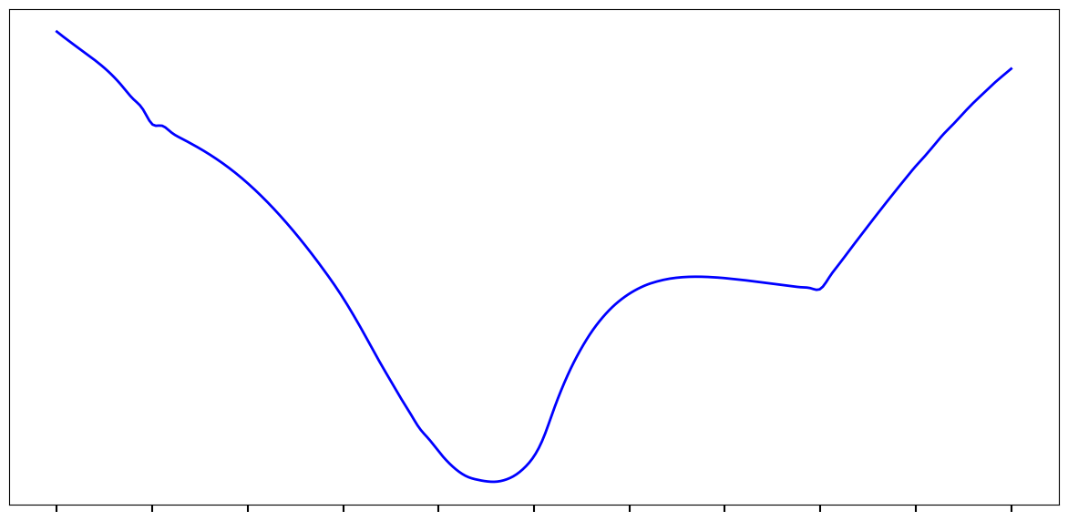
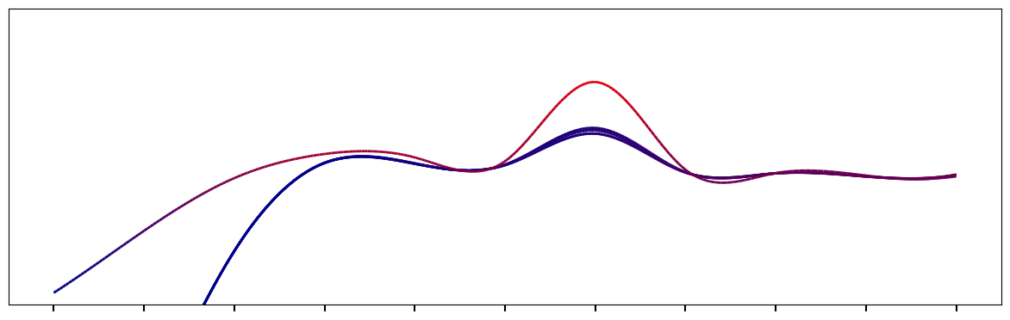
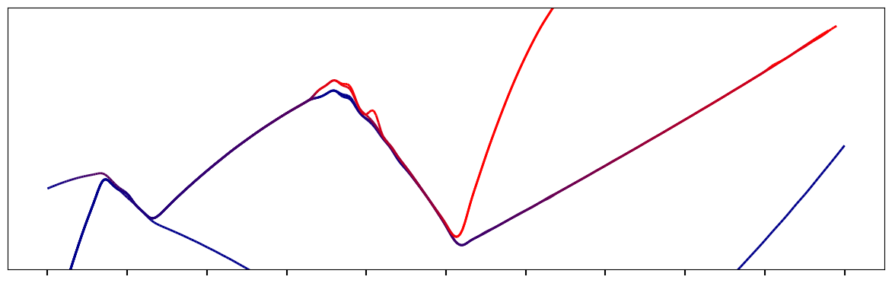
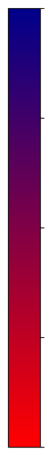
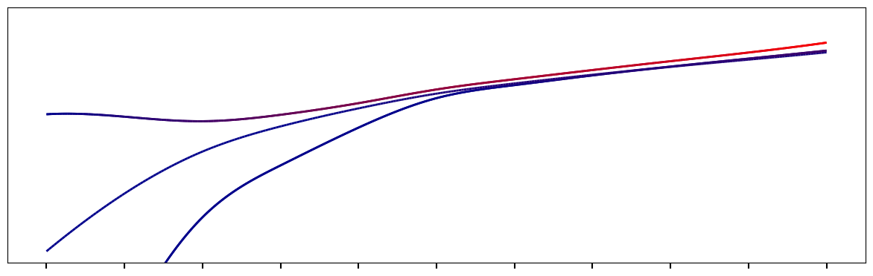
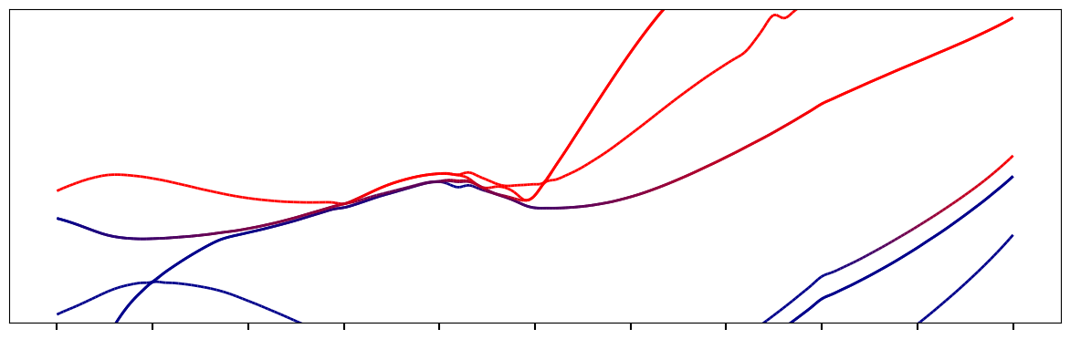
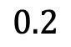
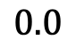
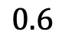
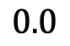
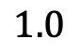
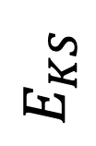
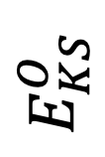
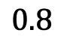
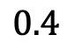
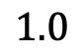
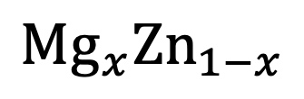
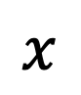
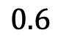
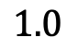
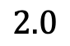
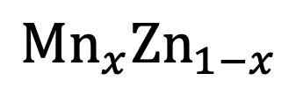
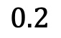
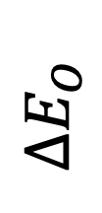
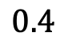
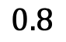
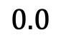
$$Mn_{x}Zn_{1−x}$$
$$Mg_{x}Zn_{1−x}$$
$$ΔE_{O}$$
$$2.0$$
$$E_{KS}$$
Occupancy
$$1.0$$
$$E_{KS}^{O}$$
$$0.0$$
$$0.0$$
$$0.2$$
$$0.4$$
$$0.6$$
$$0.8$$
$$1.0$$
$$0.0$$
$$0.2$$
$$0.4$$
$$0.6$$
$$0.8$$
$$1.0$$
$$x$$
$$x$$

Slide 2
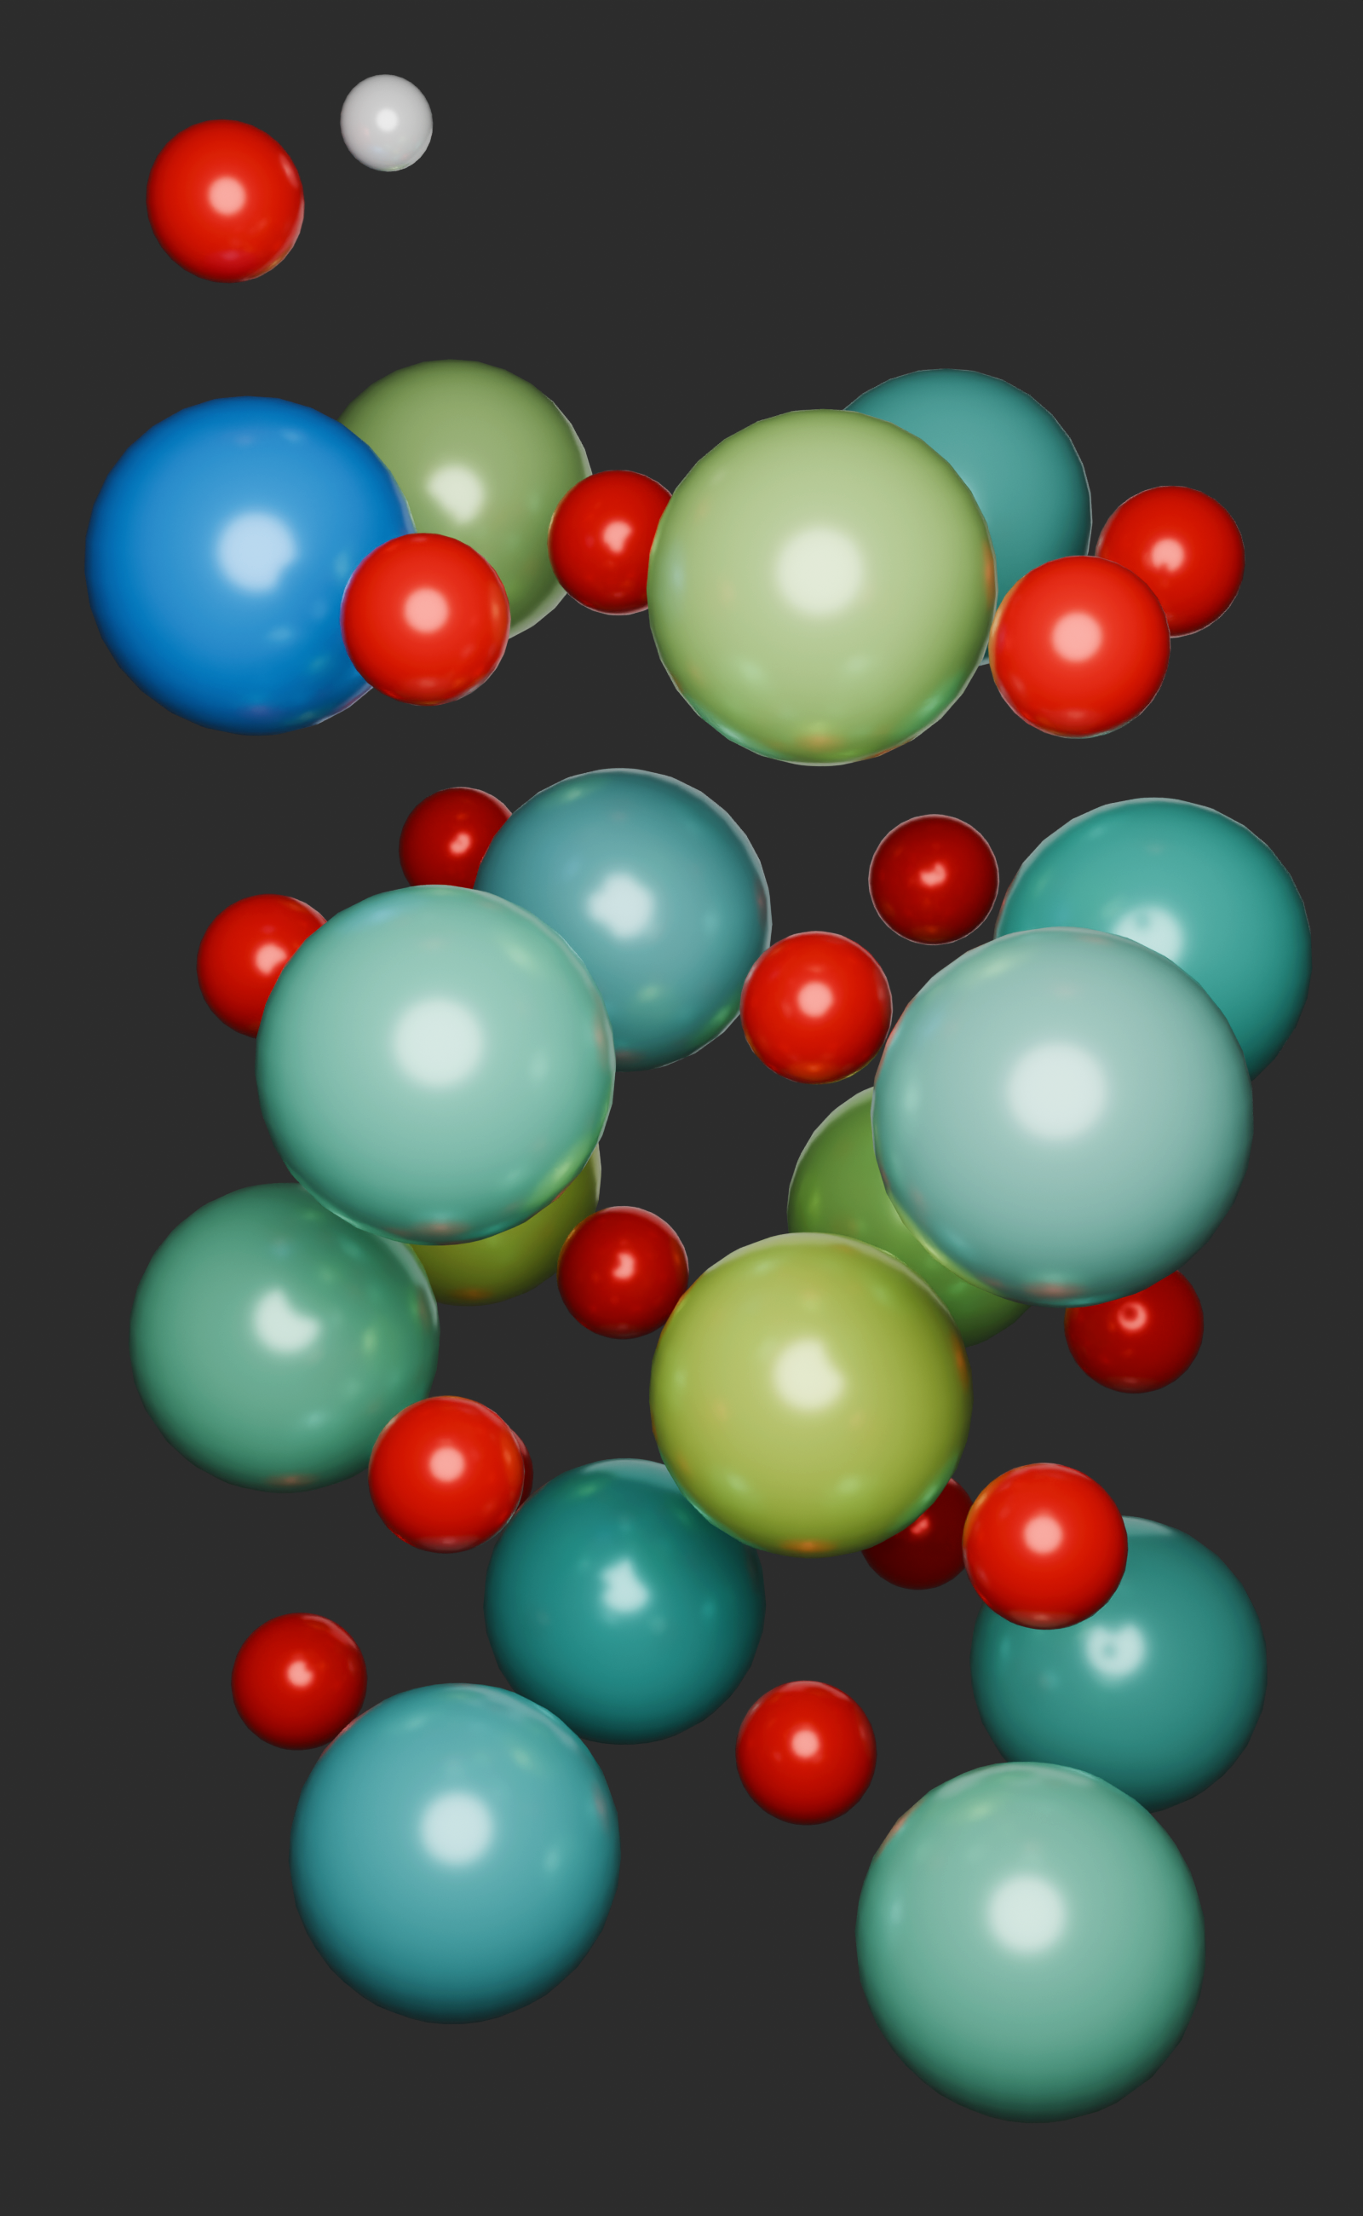
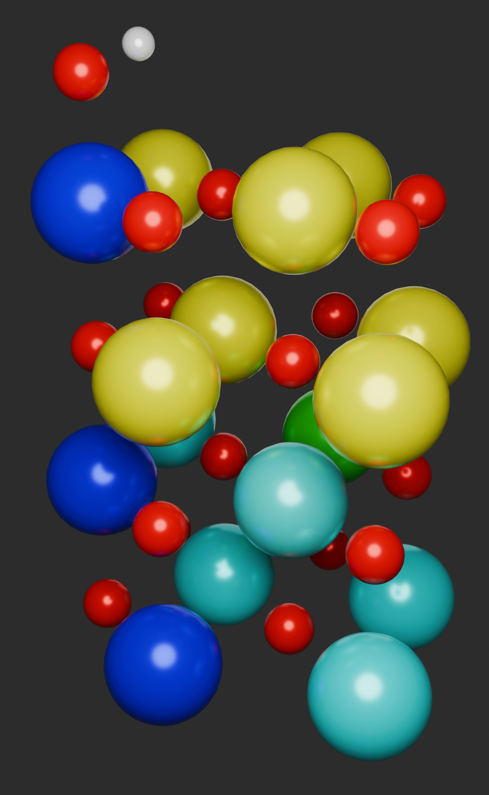
Co
Cr
Ni
V
O
Syntromization

Slide 3
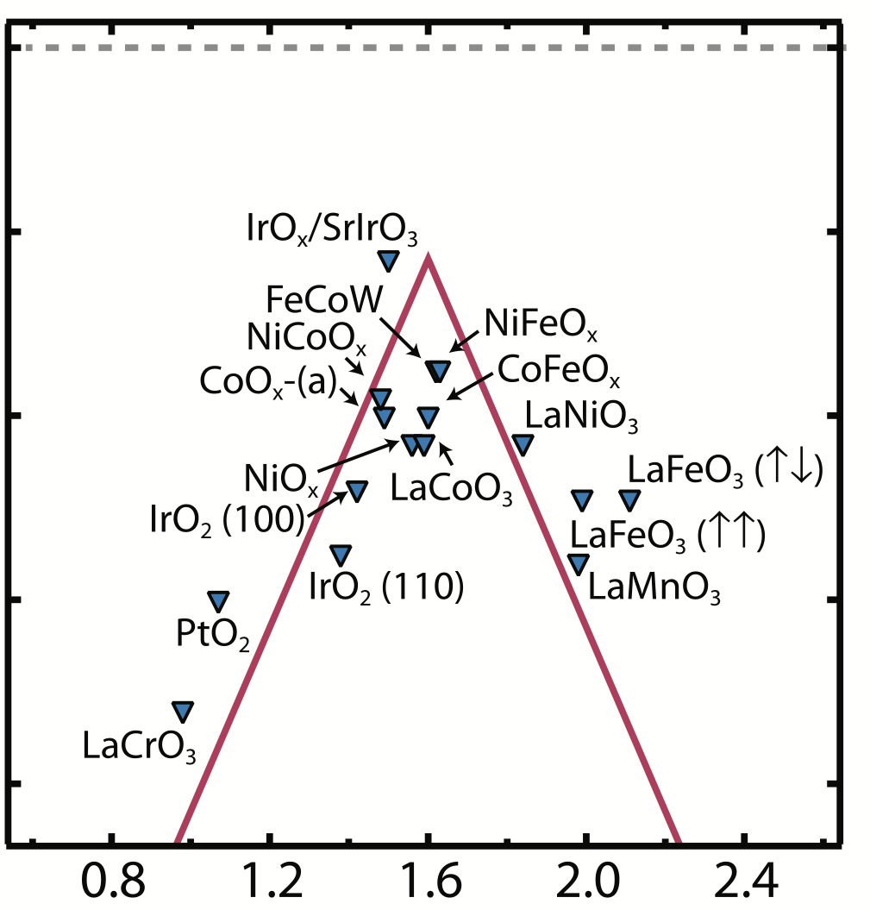
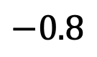
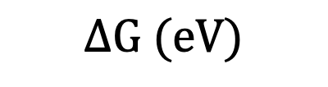
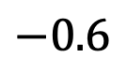
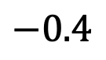
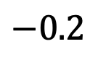
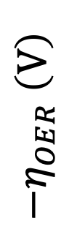
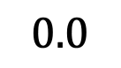
$$0.0$$
$$−0.2$$
$$−0.4$$
$$−η_{OER} \left(V\right)$$
$$−0.6$$
$$−0.8$$
$$ΔG (eV)$$

Slide 4
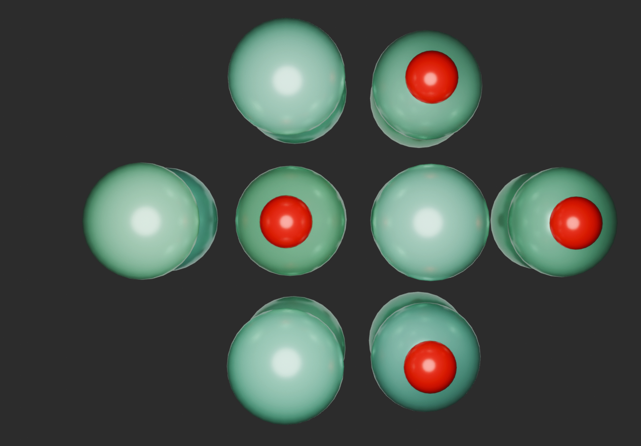
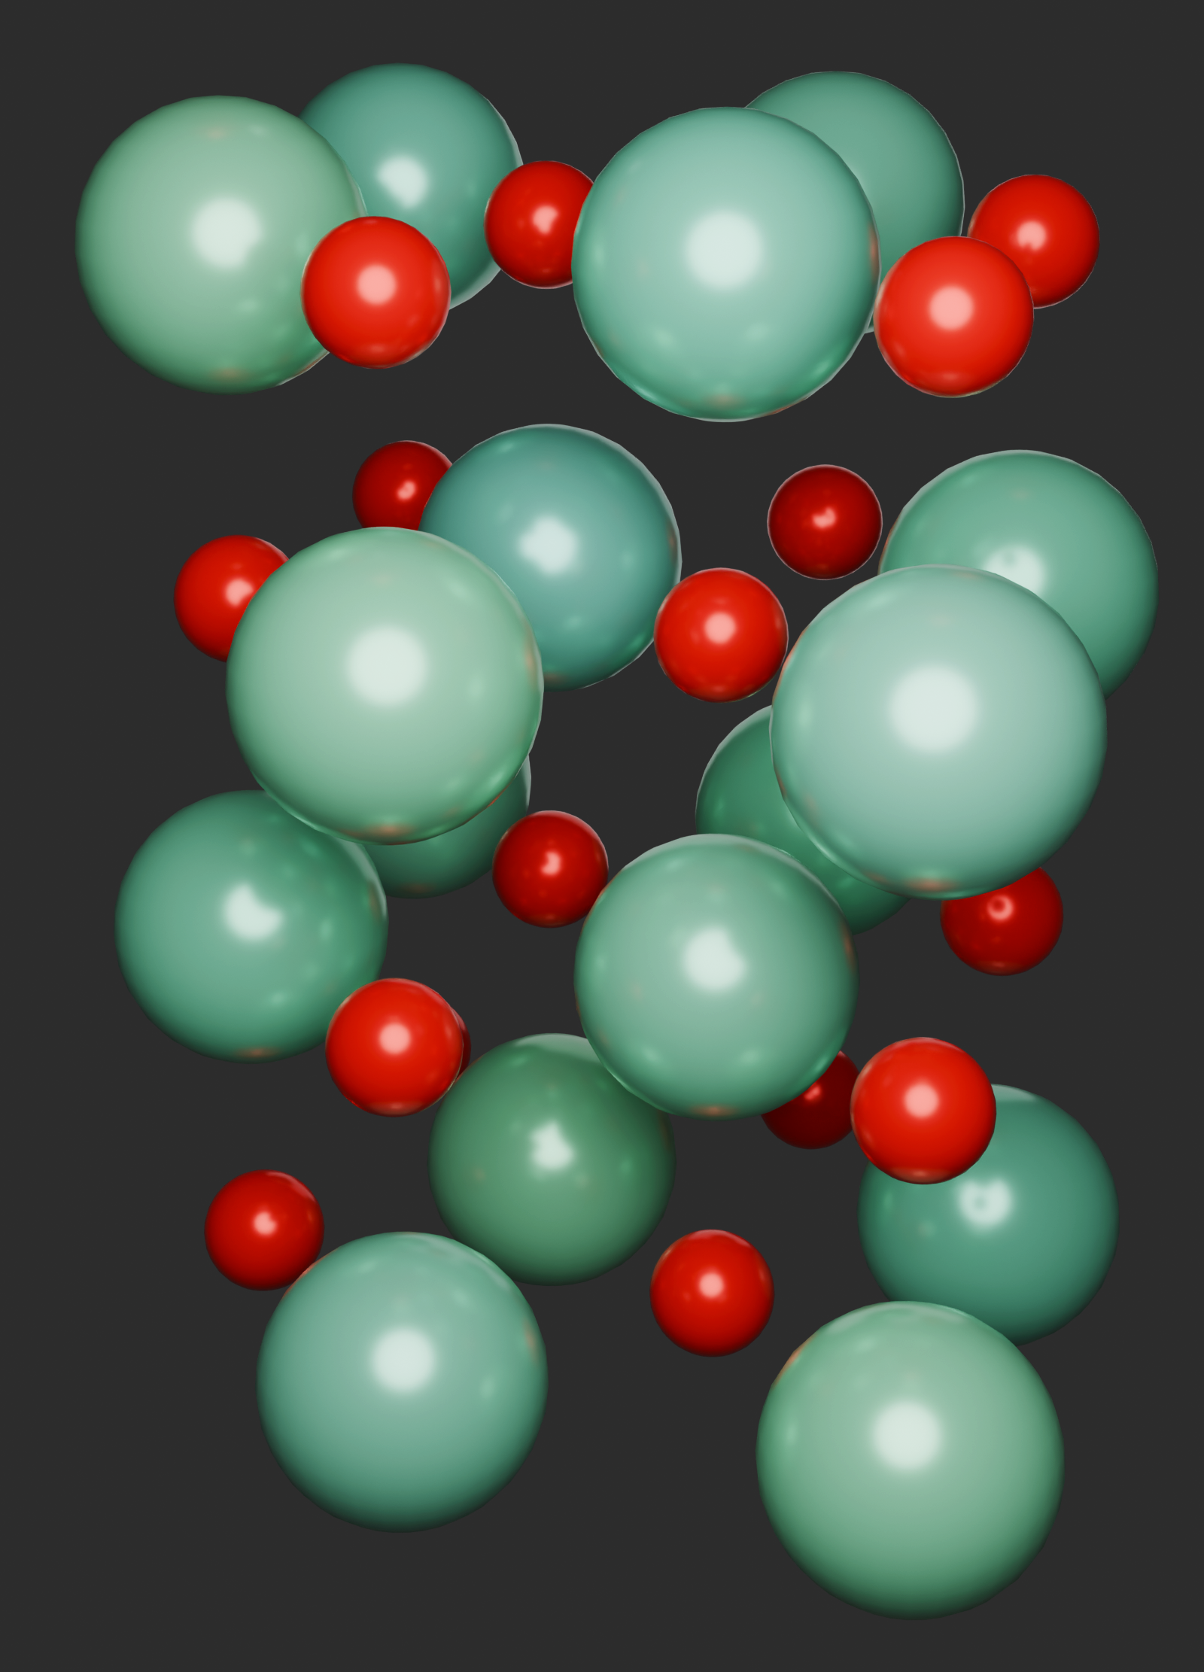
Metal
O
a)
b)

Slide 5
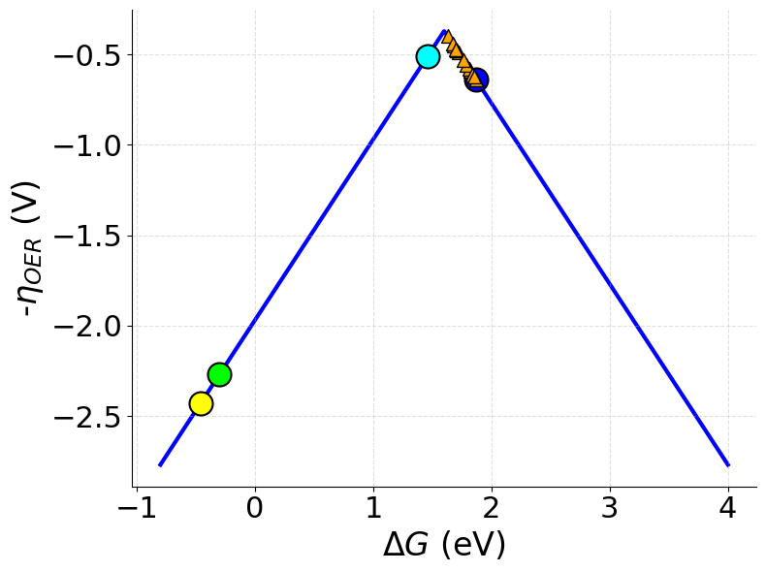
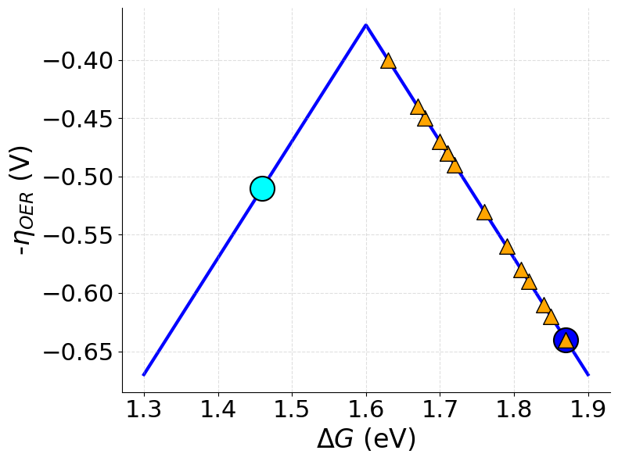
Co
Cr
Ni
V
a)
b)

Slide 6
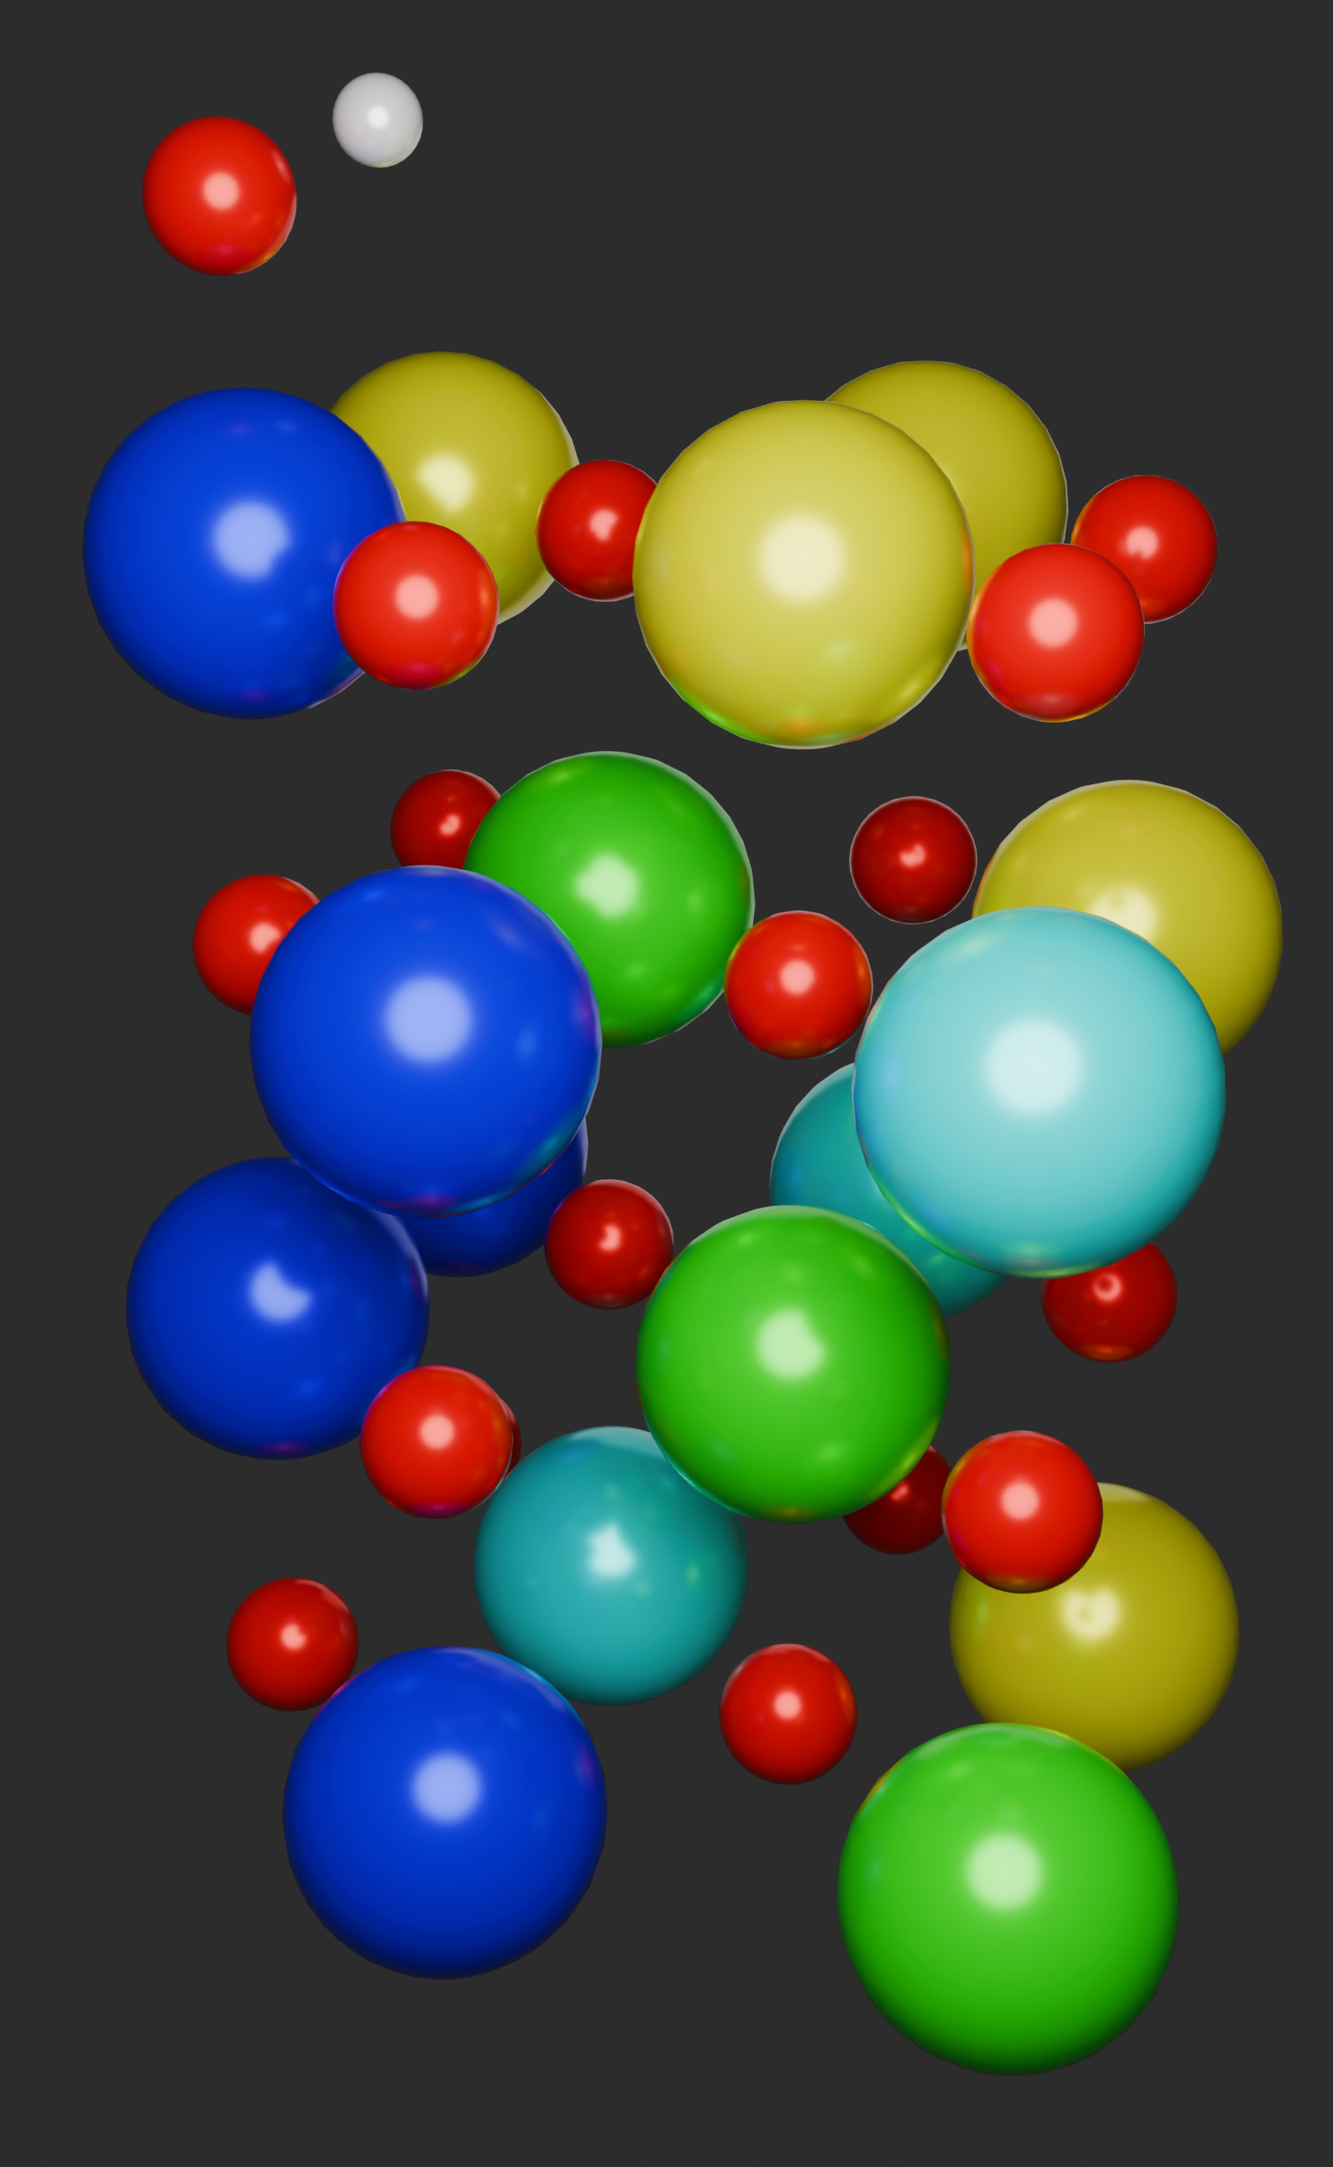
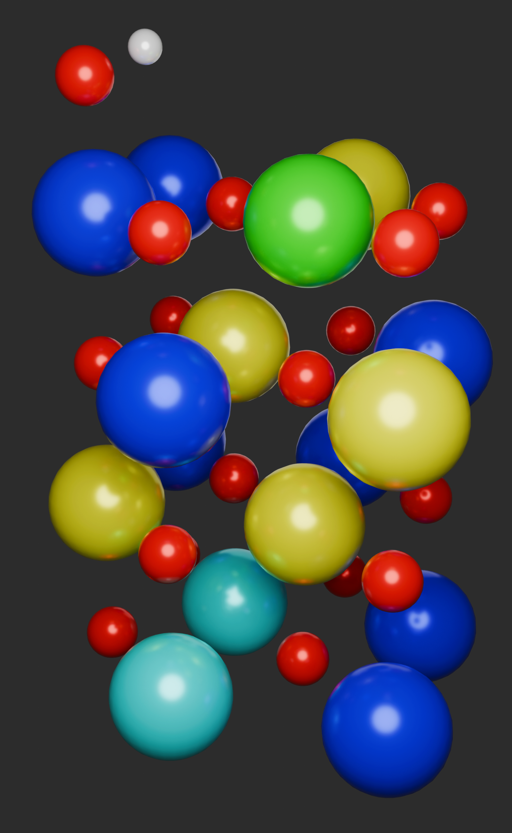
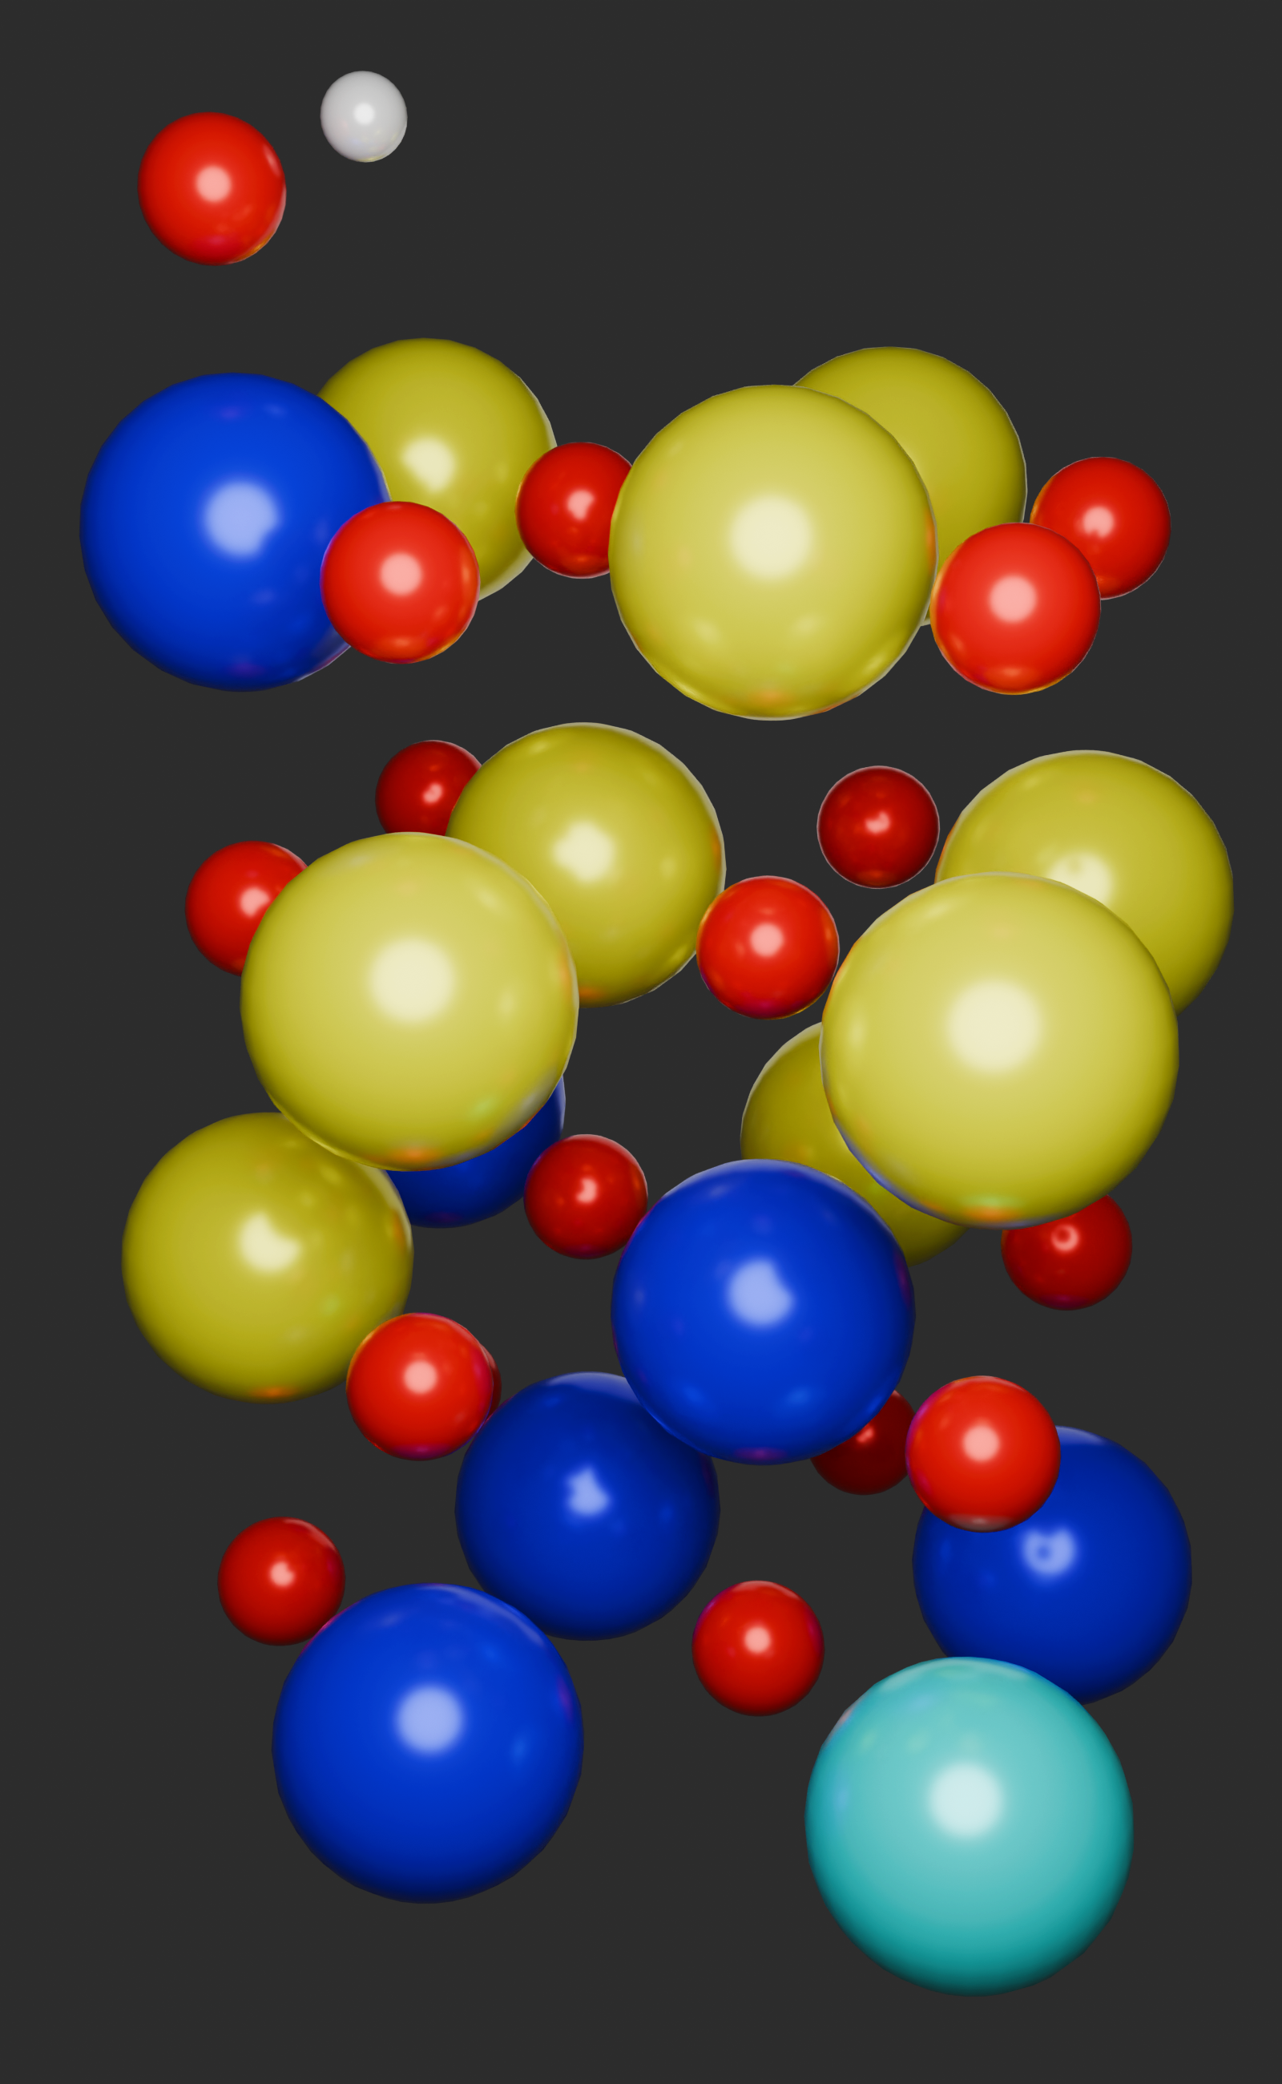
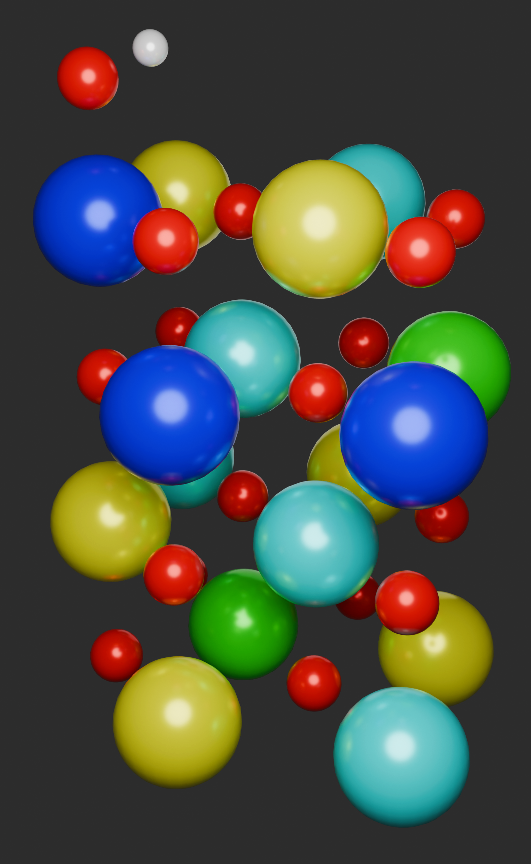
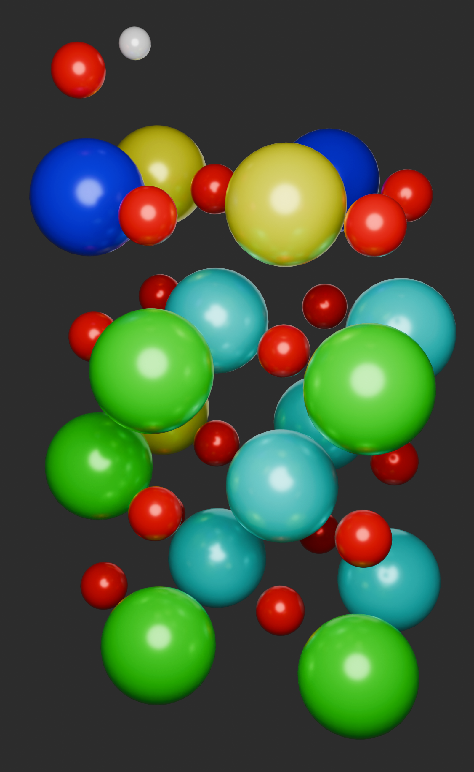
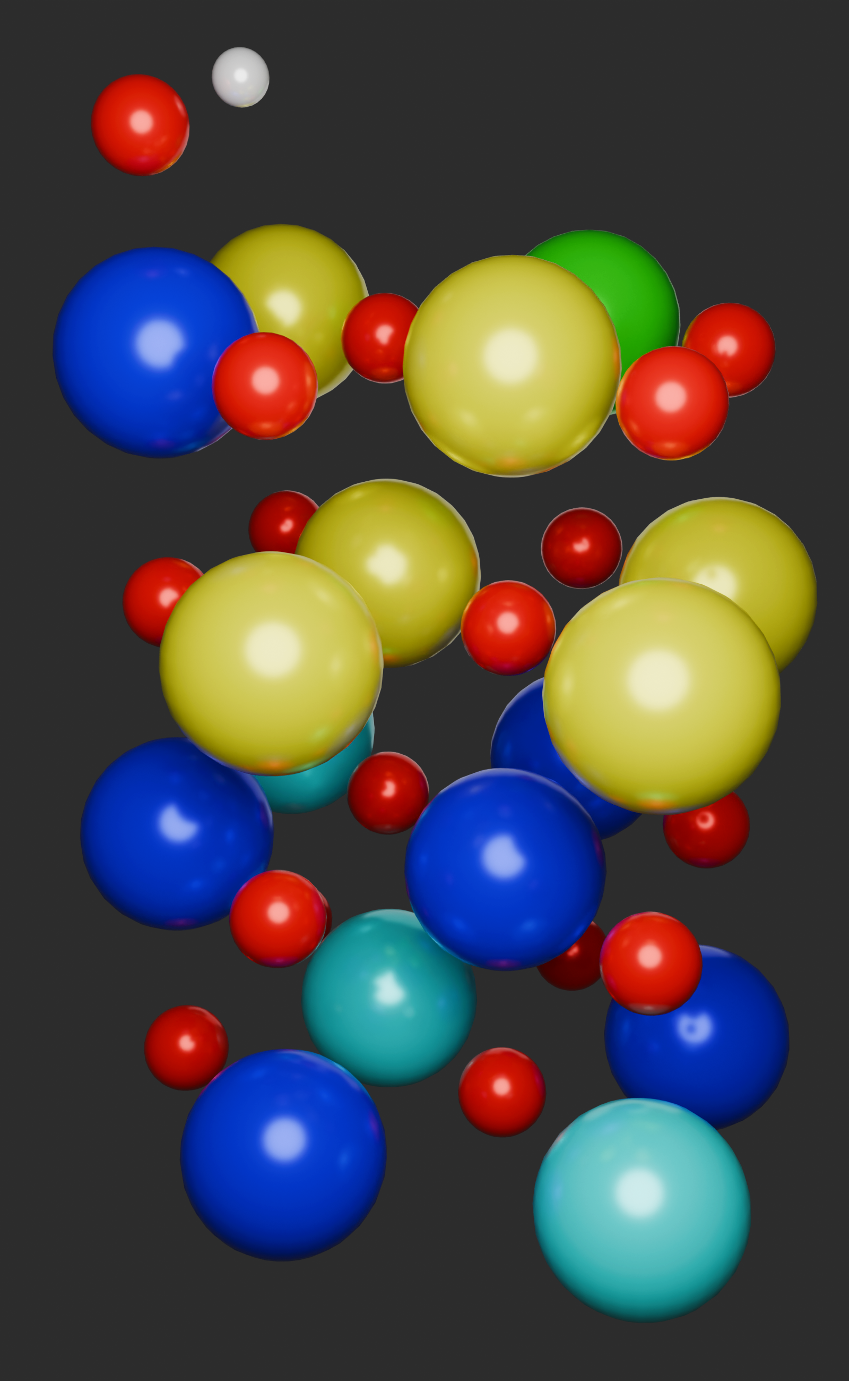
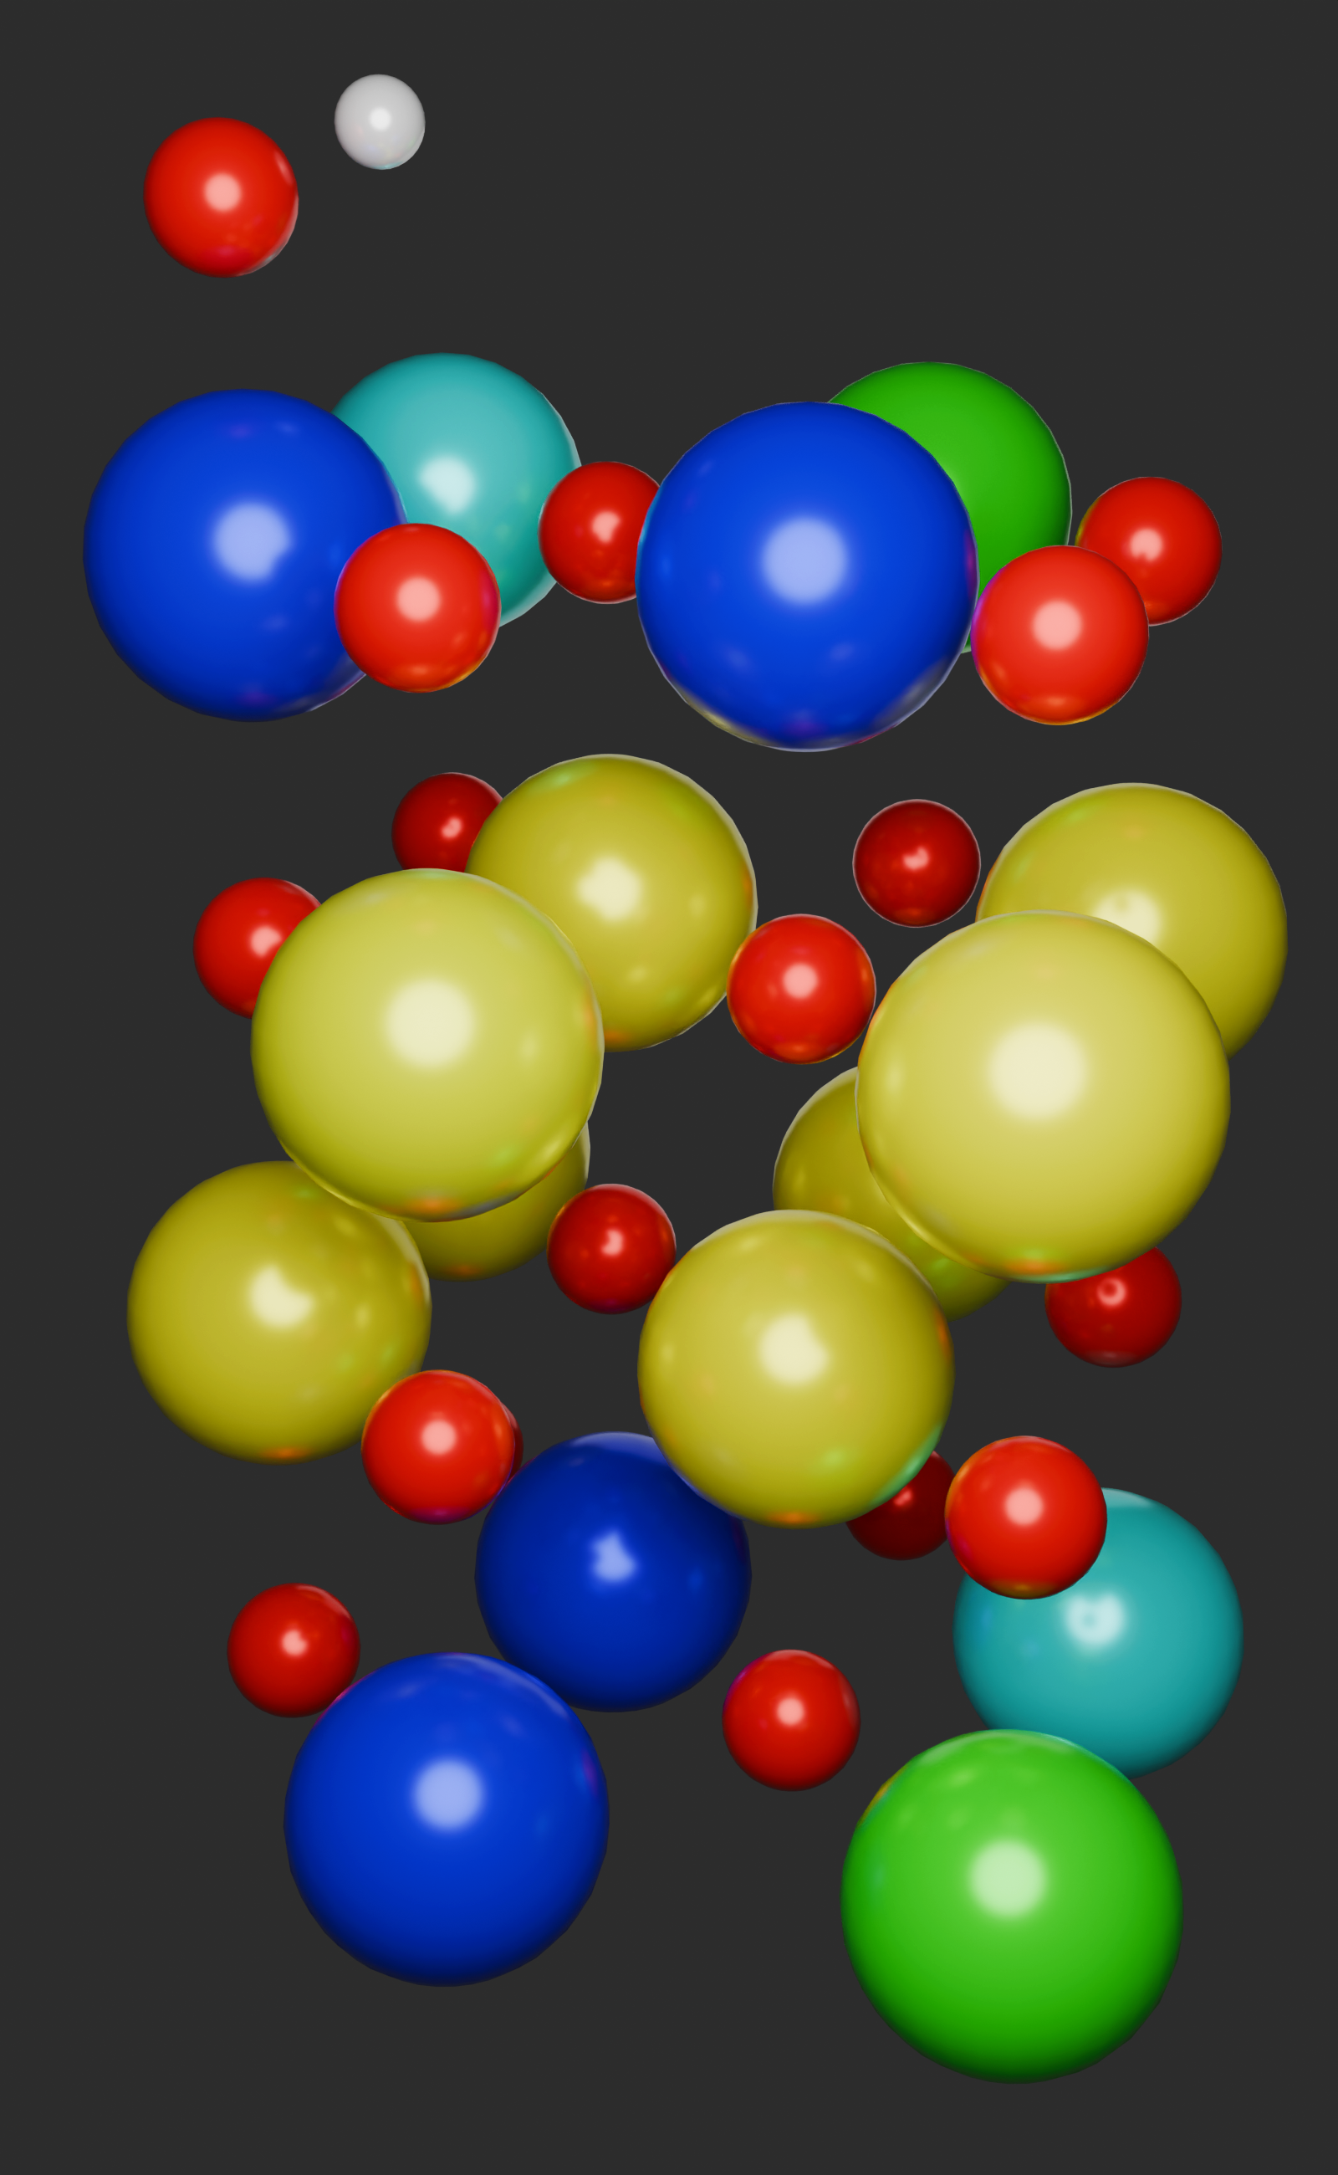
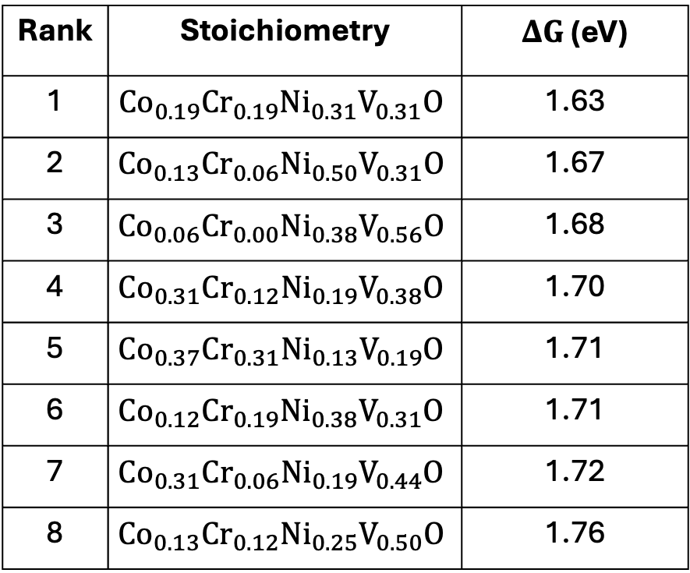
1
2
3
4
Rank | Stoichiometry | $ΔG$ (eV)
1 | $$Co_{0.19}Cr_{0.19}Ni_{0.31}V_{0.31}O$$ | 1.63
2 | $$Co_{0.13}Cr_{0.06}Ni_{0.50}V_{0.31}O$$ | 1.67
3 | $$Co_{0.06}Cr_{0.00}Ni_{0.38}V_{0.56}O$$ | 1.68
4 | $$Co_{0.31}Cr_{0.12}Ni_{0.19}V_{0.38}O$$ | 1.70
5 | $$Co_{0.37}Cr_{0.31}Ni_{0.13}V_{0.19}O$$ | 1.71
6 | $$Co_{0.12}Cr_{0.19}Ni_{0.38}V_{0.31}O$$ | 1.71
7 | $$Co_{0.31}Cr_{0.06}Ni_{0.19}V_{0.44}O$$ | 1.72
8 | $$Co_{0.13}Cr_{0.12}Ni_{0.25}V_{0.50}O$$ | 1.76
Co
Cr
Ni
V
O
H
5
6
7
8

Slide 7


Co
Ni
V
a)
b)

Slide 8




1
2
3
4
Rank | Stoichiometry | $ΔG$ (eV)
1 | $$Co_{0.19}Cr_{0.06}V_{0.31}{Ni}_{0.44}O$$ | 1.63
2 | $$Co_{0.13}Cr_{0.06}V_{0.31}{Ni}_{0.50}O$$ | 1.55
3 | $$Co_{0.31}Cr_{0.06}V_{0.44}{Ni}_{0.19}O$$ | 1.49
4 | $$Co_{0.06}Cr_{0.00}V_{0.56}{Ni}_{0.38}O$$ | 1.45
5 | $$Co_{0.19}Cr_{0.19}V_{0.31}{Ni}_{0.31}O$$ | 1.76
6 | $$Co_{0.18}Cr_{0.00}V_{0.44}{Ni}_{0.38}O$$ | 1.41
7 | $$Co_{0.06}Cr_{0.06}V_{0.38}{Ni}_{0.5}O$$ | 1.30
8 | $$Co_{0.19}Cr_{0.19}V_{0.31}{Ni}_{0.31}O$$ | 2.00
Co
Cr
Ni
V
O
H
5
6
7
8

